Slide 1
Good & Bad In gaming
Team Napoleon
What makes a good and a bad game?

Slide 2
Art direction / Graphics
Saku

Slide 3
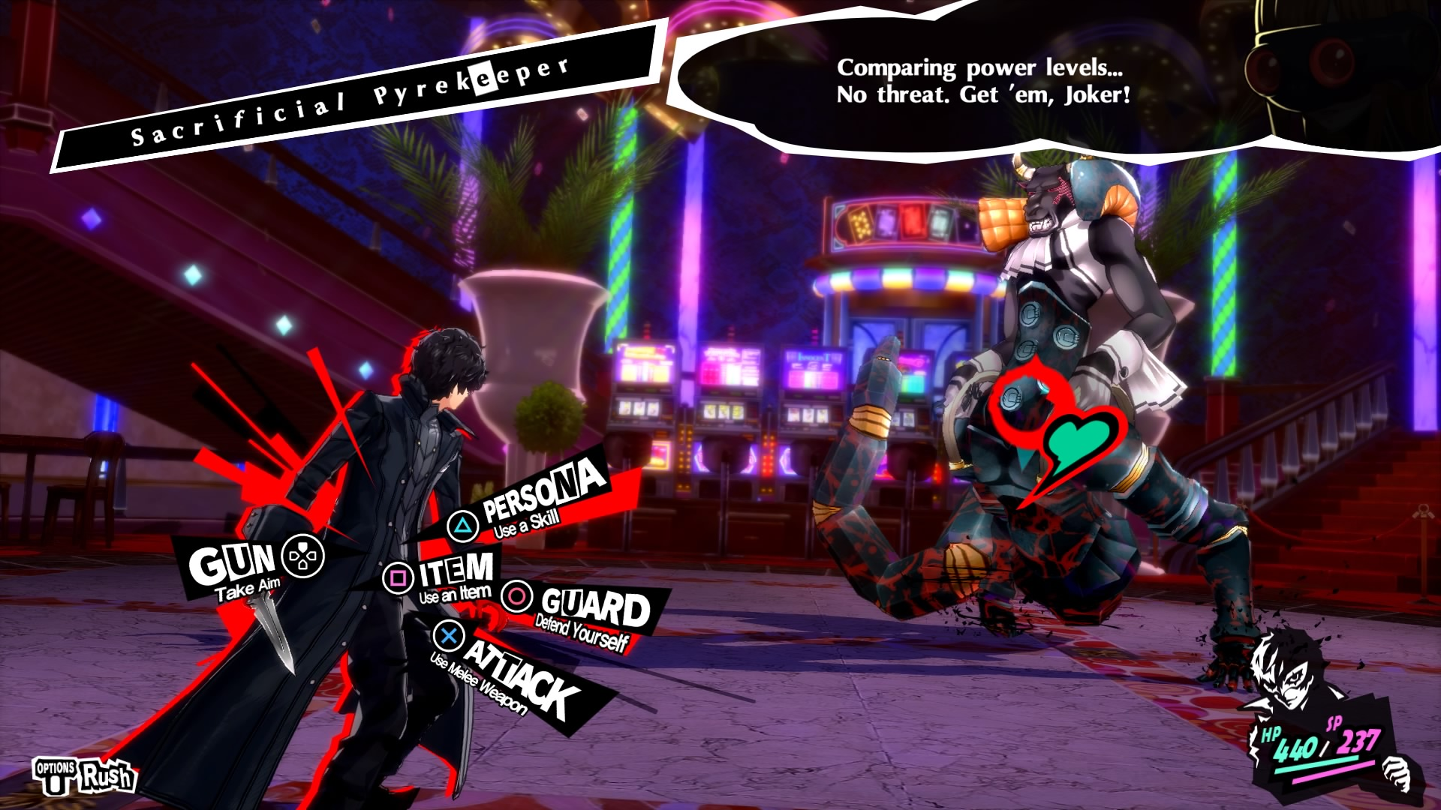
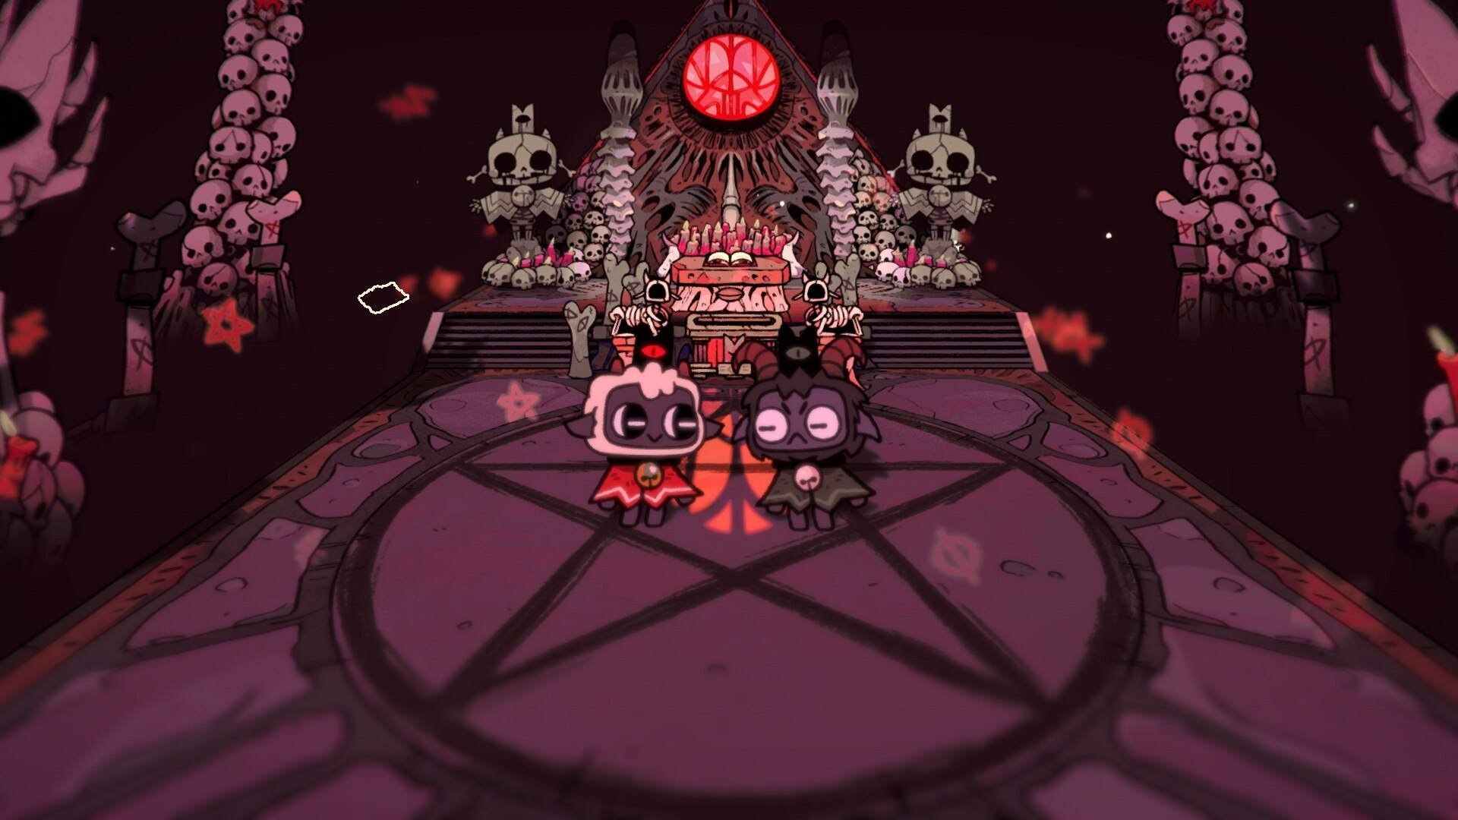
The good
Strong, unique, inspired
Grabs the viewer's attention quickly
Differentiates itself from the others
Brings the world and the ideas of the creator to life
Provide good visual clarity
Persona 5
Cult of the Lamb
Cuphead
The Legend of Zelda: Breath of the Wild
Red Dead Redemption 2

Slide 4
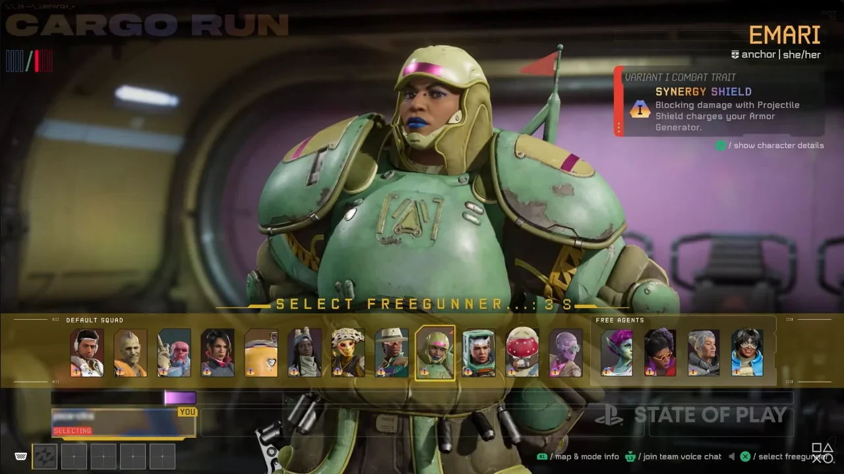
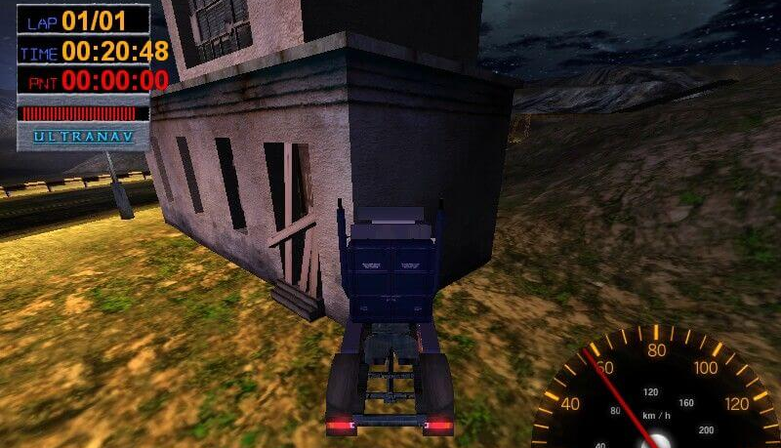
The Bad
Bland, boring, uninspired
Uncanny characters
Stiff & unresponsive animations
Cluttered & unintuitive UI/UX
Inconsistency
Concord
Big Rigs: Over the road racing
The Day Before
Bubsy 3D

Slide 5
Story and Dialogue
Aleksi

Slide 6
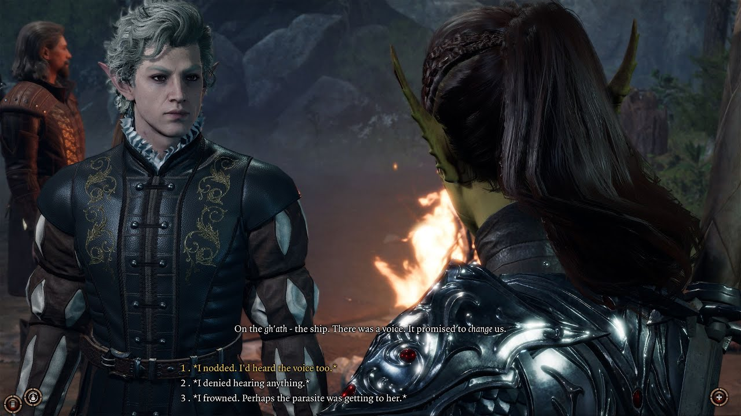
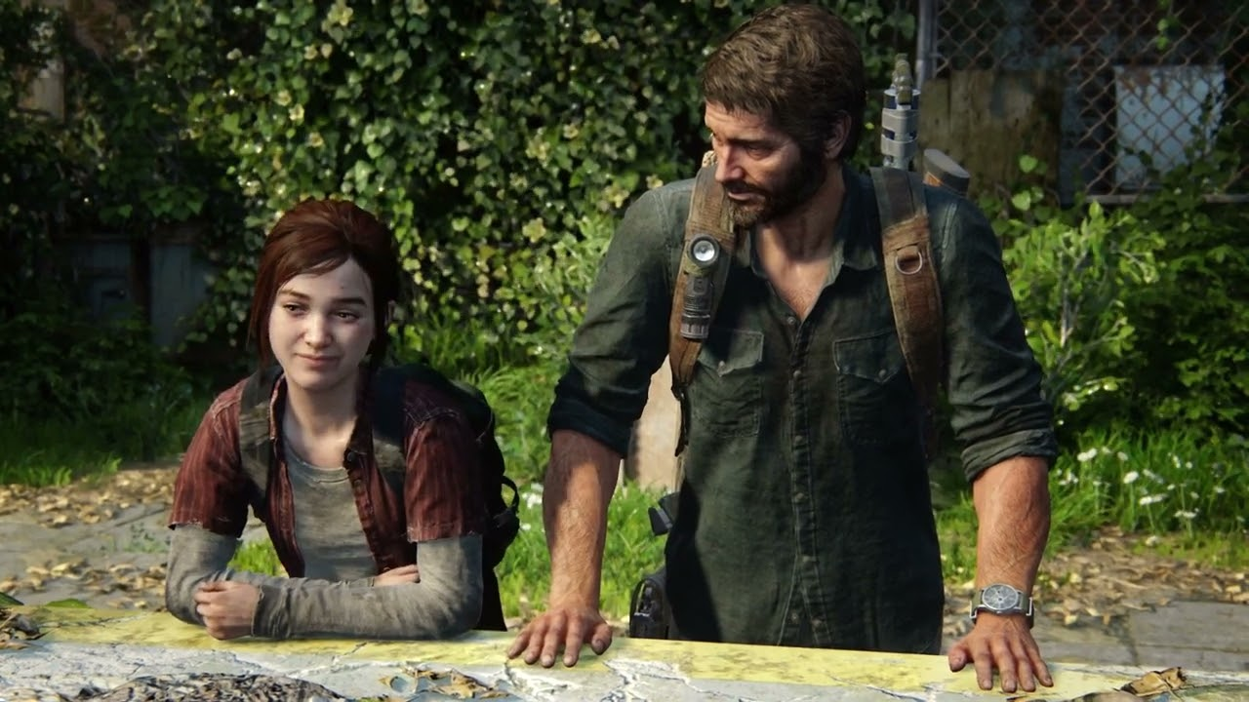
The good
Entertaining Story
Player's Choices have an impact
Well-written dialogue
Baldurs Gate 3
Last of us
God of war
GTA V

Slide 7
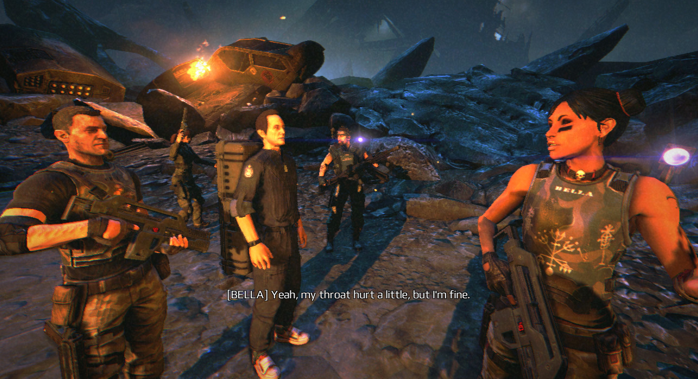
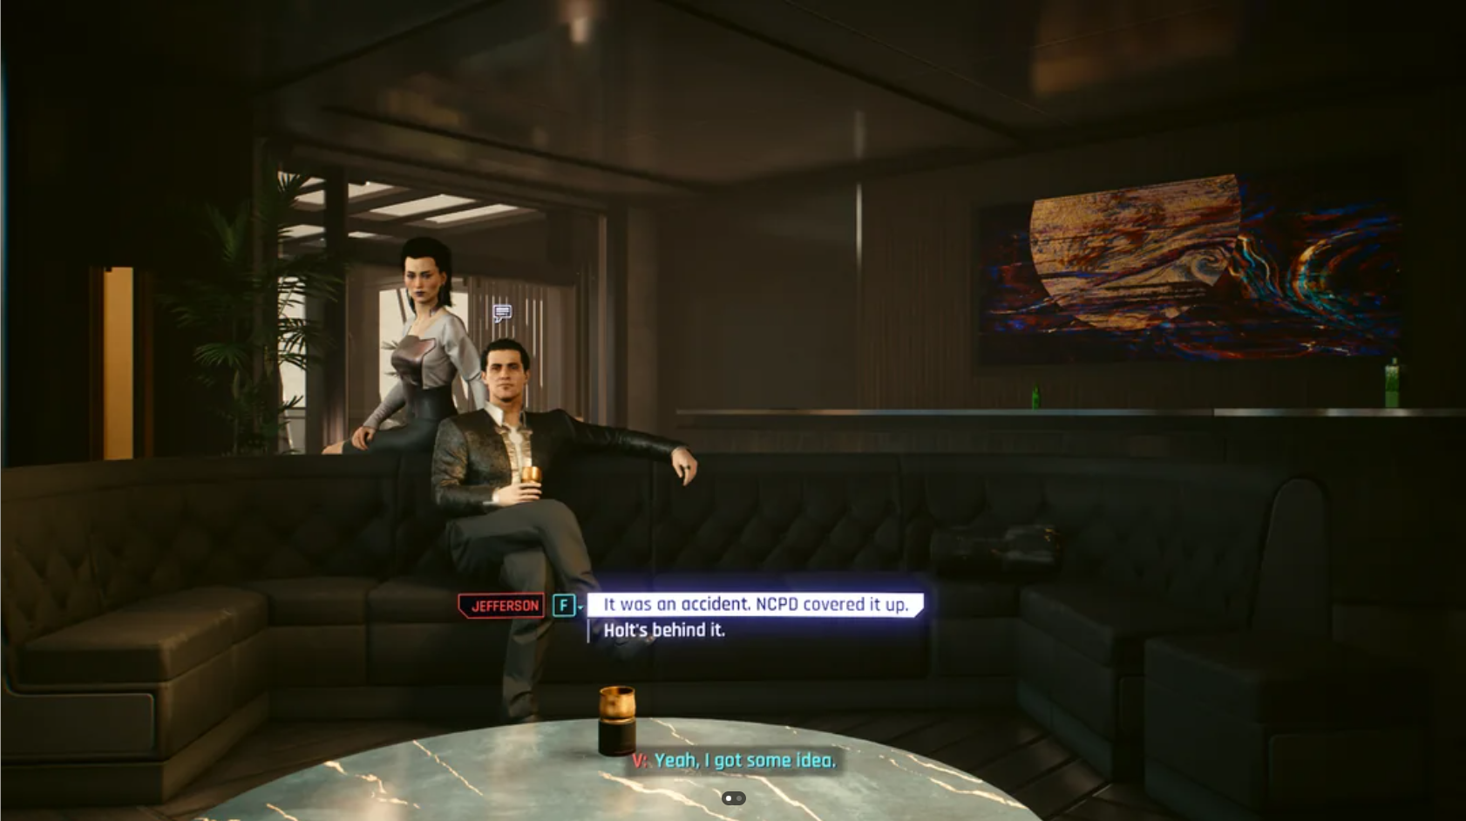
The Bad
Story feels forced, dull or illogical.
Characters one-dimensional or stereotypical
Dialogue is awkward or cliché
Example: Aliens: Colonial Marines Cyberpunk 2077

Slide 8

Arttu
Sound design

Slide 9
The good
Conveying Emotions
Suitability to theme and environment
Responsive to player actions
Variety and detail
Escape From Tarkov
Alan Wake II
Counter Strike
Trackmania

Slide 10
The Bad
Repetitiveness and predictability
Inappropriate sounds
Inconsistency in sounds
Imbalance in sound volume
Apex Legends
Cyberpunk 2077
Resident Evil 6

Slide 11
Janne
Setting and world

Slide 12
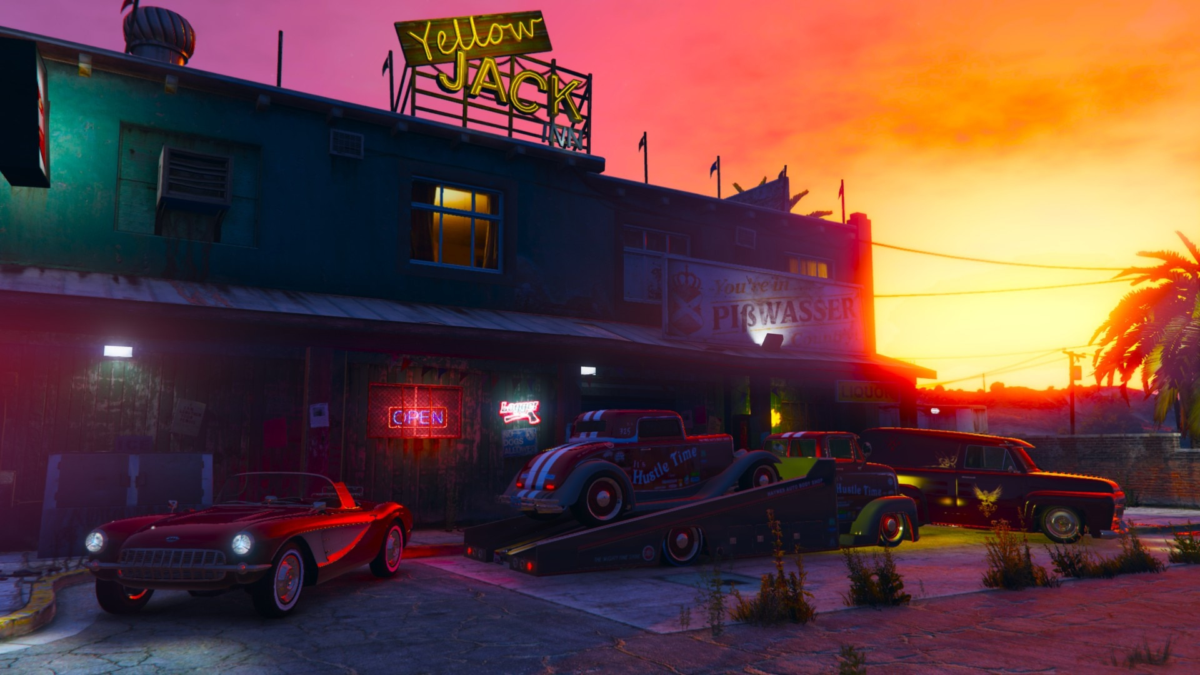
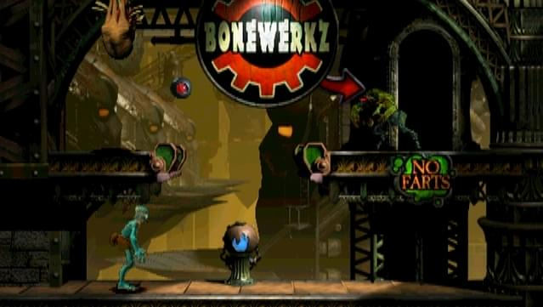
The good
Immersive world
Visual style
Interactive environment
Dynamic and evolving setting
Rich lore and background story
Theme and atmosphere
Engaging NPCs and factions
Grand Theft Auto
Oddworld
World of Warcraft
The Elder Scrolls
Baldur's Gate 3

Slide 13
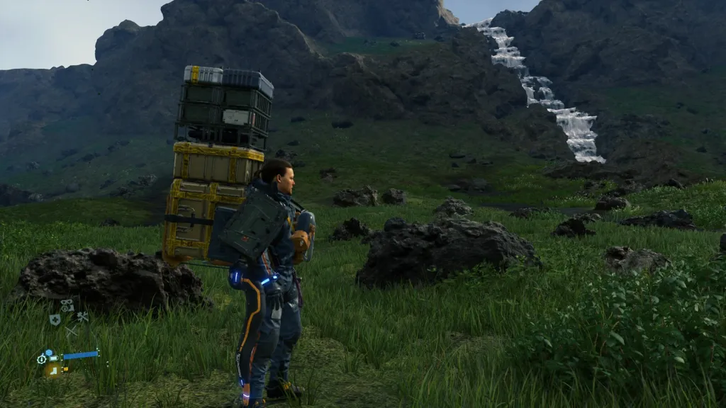
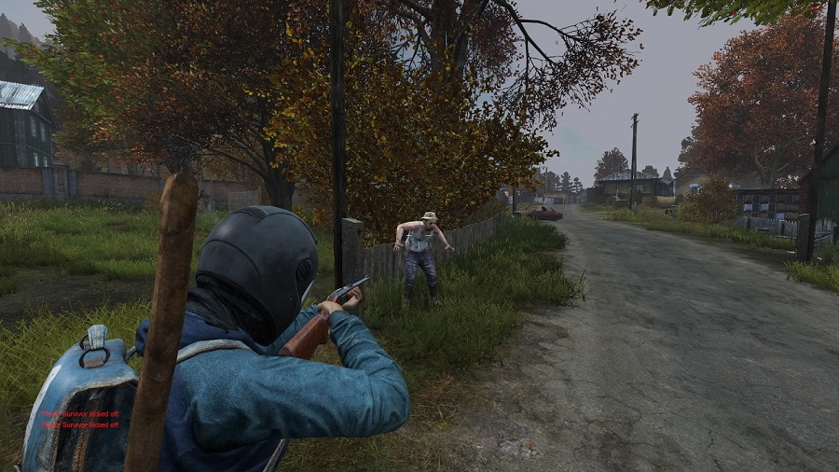
The Bad
Lack of depth or detail
Poorly integrated lore
Repetitive or empty environments
Inconsistent style or theme
Unclear boundaries and objectives
Static world elements
Death Stranding
DayZ standalone
Battlefield 2042

Slide 14
Challenge
Joona

Slide 15
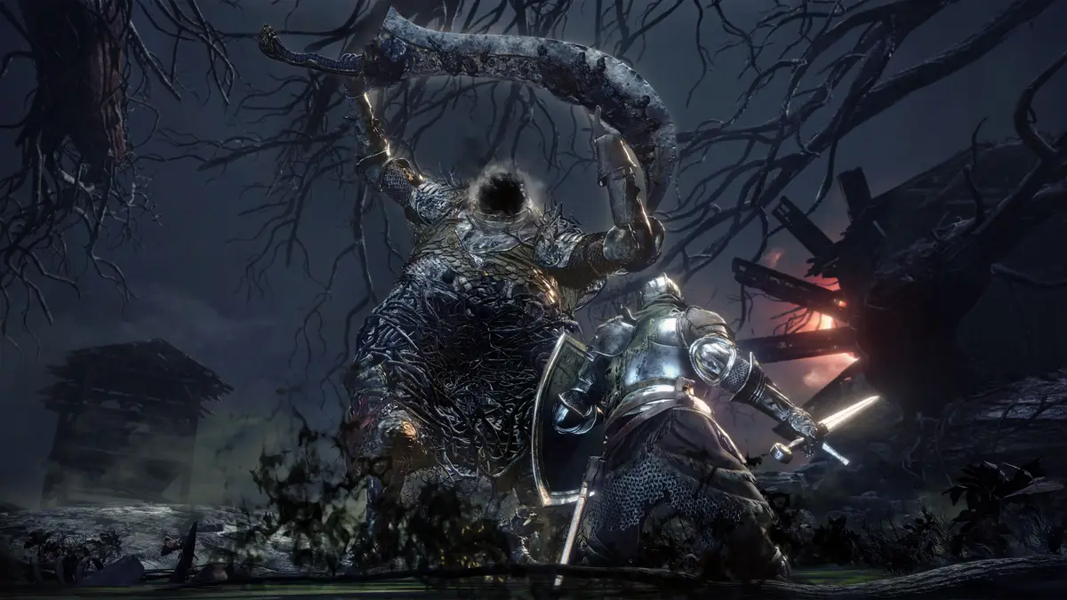
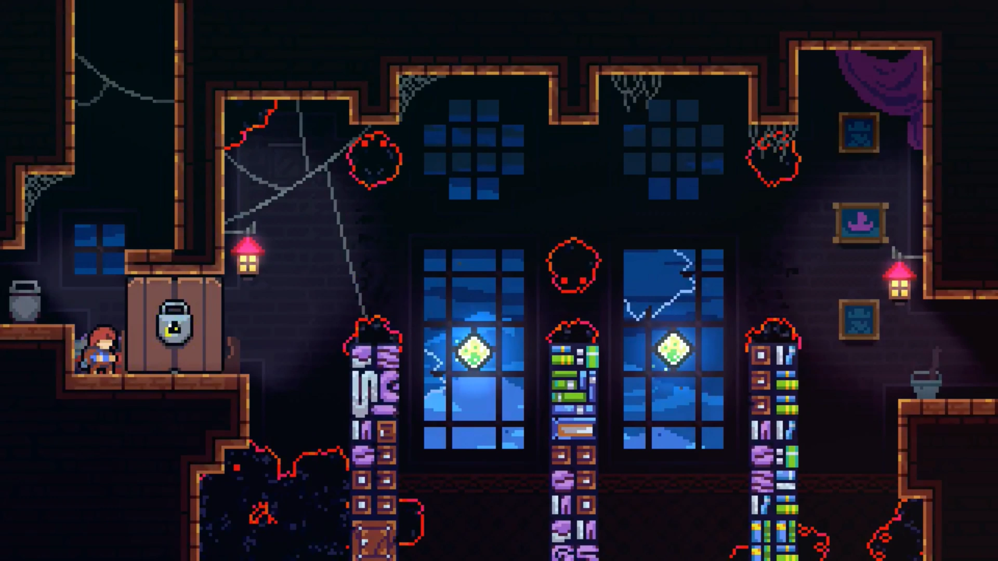
The good
Balance
Progression
Clear goals
Variety
Adaptability
Examples:
Dark Souls series
Celeste

Slide 16
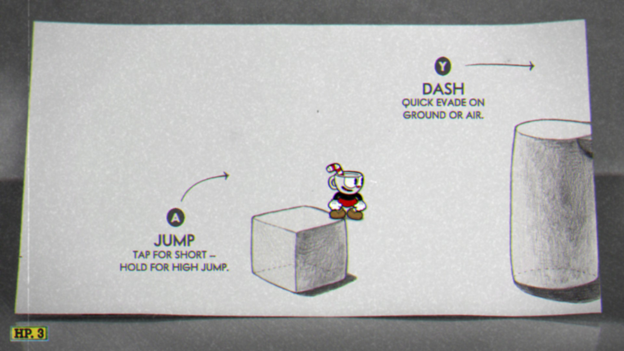
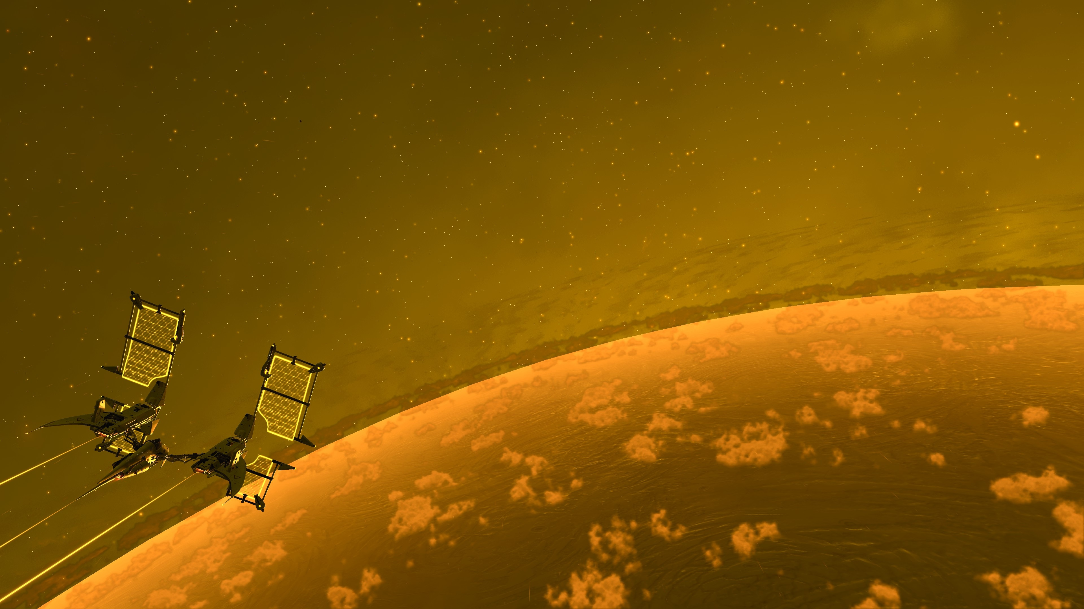
The Bad
Excessive difficulty
Unclear objectives
Repetitive challenges
Poorly designed mechanics
Lack of rewarding progress
Pacing
Examples:
Cuphead
No Man's Sky

